Slide 1
E-Learning Website
‘Cosmoscope’
Presented by: Moahammad Saif
Enrollment no.: U2349013
Course: MCA IV Semester
Project Guide: Dr. Farha

Slide 2
Contents
Introduction
Problem Statements
Motivations
Objective
Literature Reviews
Requirements: Hardware and software
System Design
Project Outputs
Testing Strategy
Conclusion
Future Scopes
Reference

Slide 3
Introduction
COSMOSCOPE has been designed as an e-learning platform to explore the wonders of cosmology and space. It has provided interactive tools to make learning about astronomy more accessible and engaging.

Slide 4
Problem Definition
Lack of Interactivity: Static text and images can't show the dynamic nature of the solar system.
Limited Engagement: No interactive elements make it hard to keep learners interested.
Outdated Information: They might not include the latest discoveries and news.

Slide 5
Motivations
Make Learning Fun: Use 3D models and animations.
Encourage Ongoing Learning: Keep users interested and learning over time.
Inspire Future Scientists: Spark interest in astronomy and science careers.

Slide 6
Objective
To enhanced the Cosmoscope platform by integrating advanced interactive features, including a 3D model of the Milky Way galaxy, an AI-powered chatbot for cosmology-related inquiries, a quiz-based learning module to engage users, and an e-commerce section for space-themed products.

Slide 7
Minimum Software Requirements
Operating System : Windows 10/Linux
Browser : Google Chrome, Mozilla Firefox
Programming Languages : HTML, CSS, JavaScript
Database : MySQL
Version Control : Git
IDE : Visual Studio Code, PyCharm

Slide 8
Minimum Hardware Requirements
Processor : Intel Core i5 or equivalent
RAM : 8GB minimum
Storage : 500GB HDD or SSD
Graphics Card : NVIDIA GeForce GTX 1050 or equivalent
Internet Connection : Broadband connection with 10 Mbps speed

Slide 9
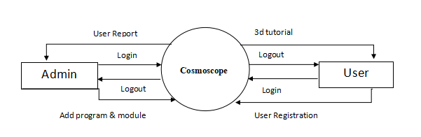
DFD (Dataflow Diagram)
level 0

Slide 10
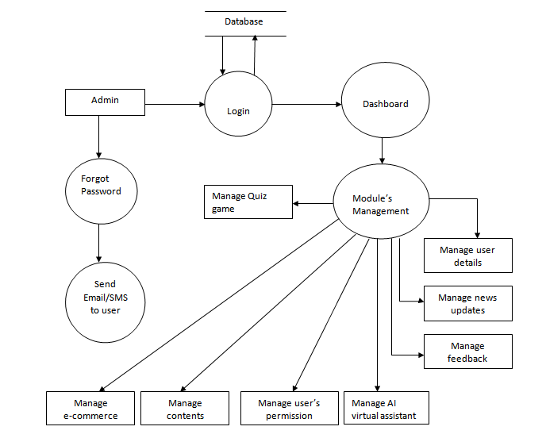
Level -1

Slide 11
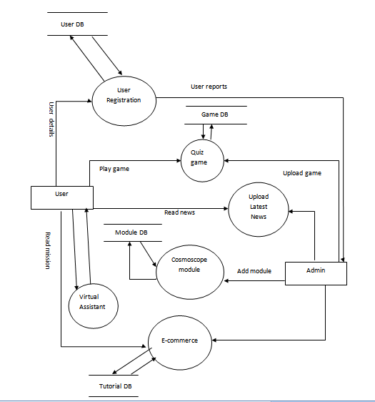
level 2

Slide 12
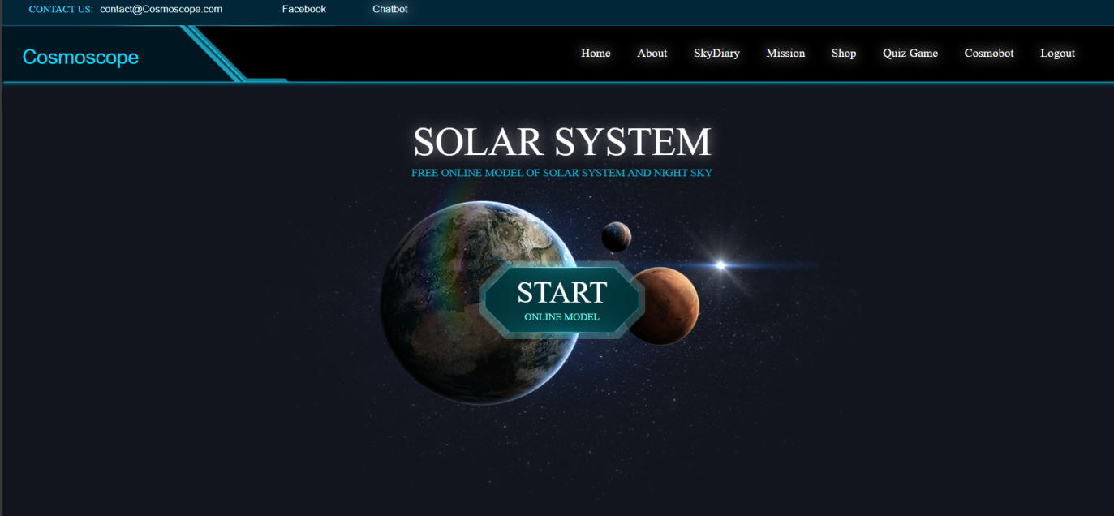
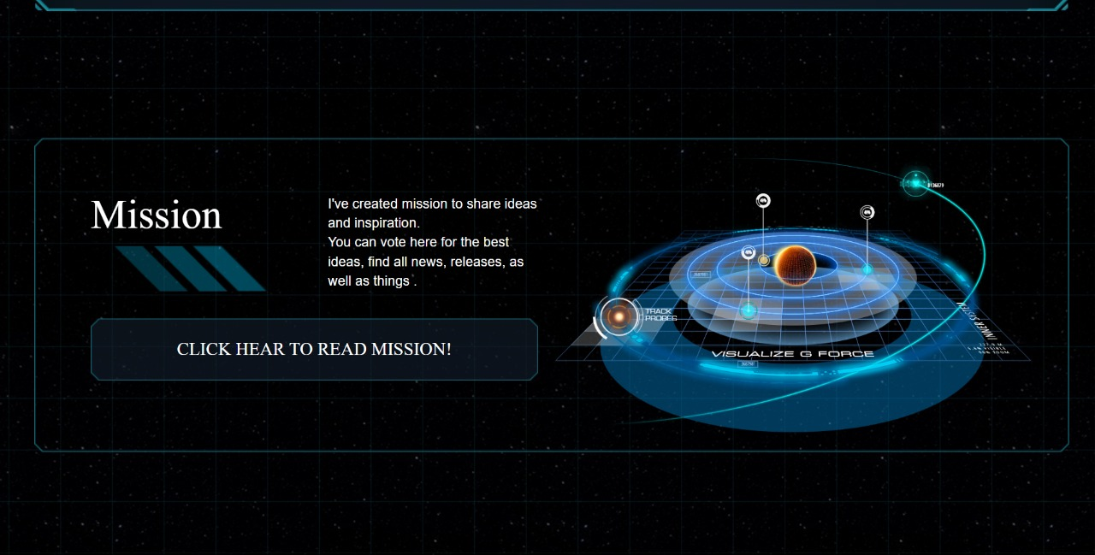
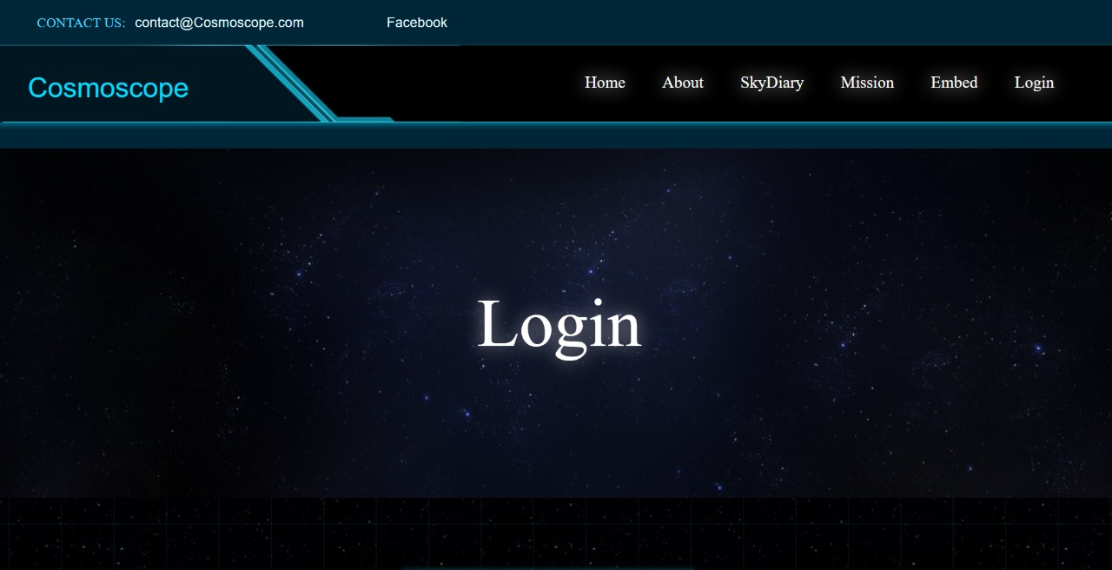
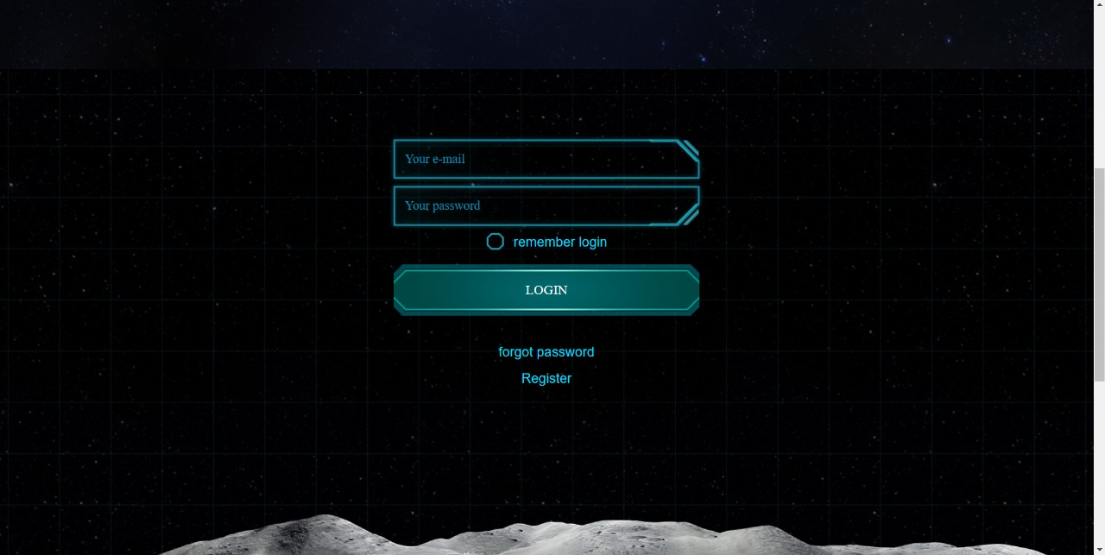
Project Output

Slide 13
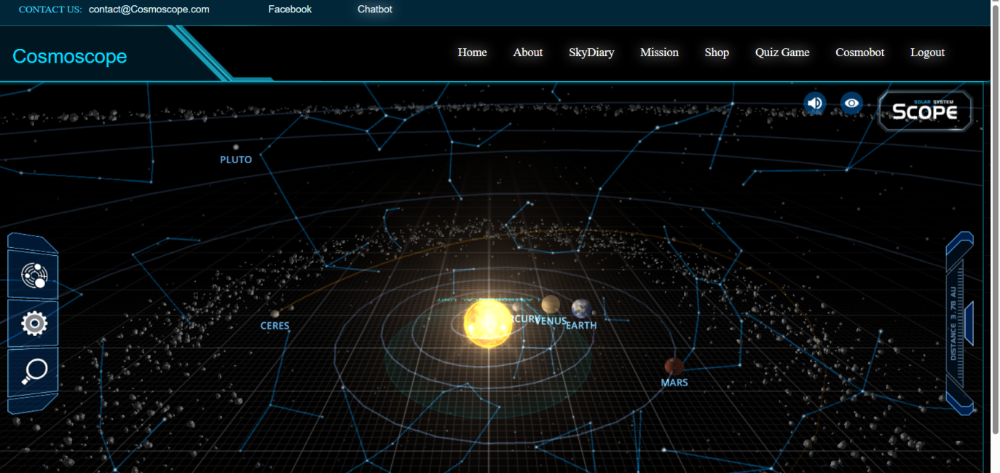
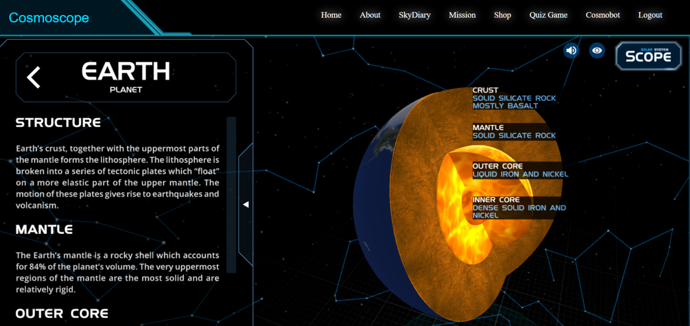
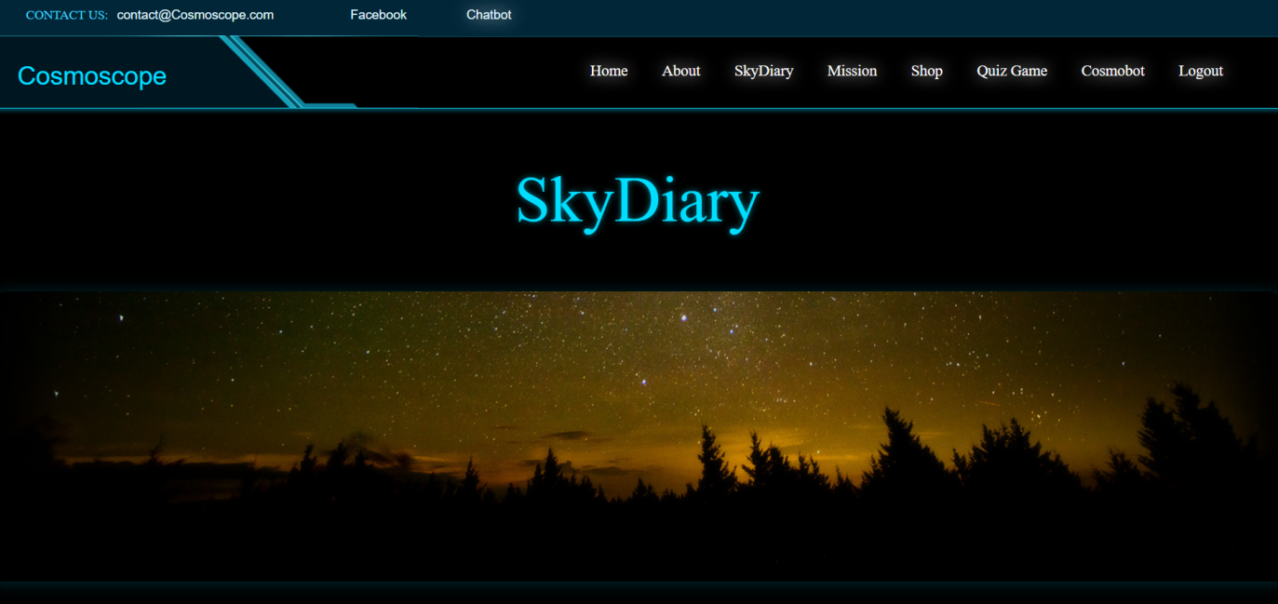
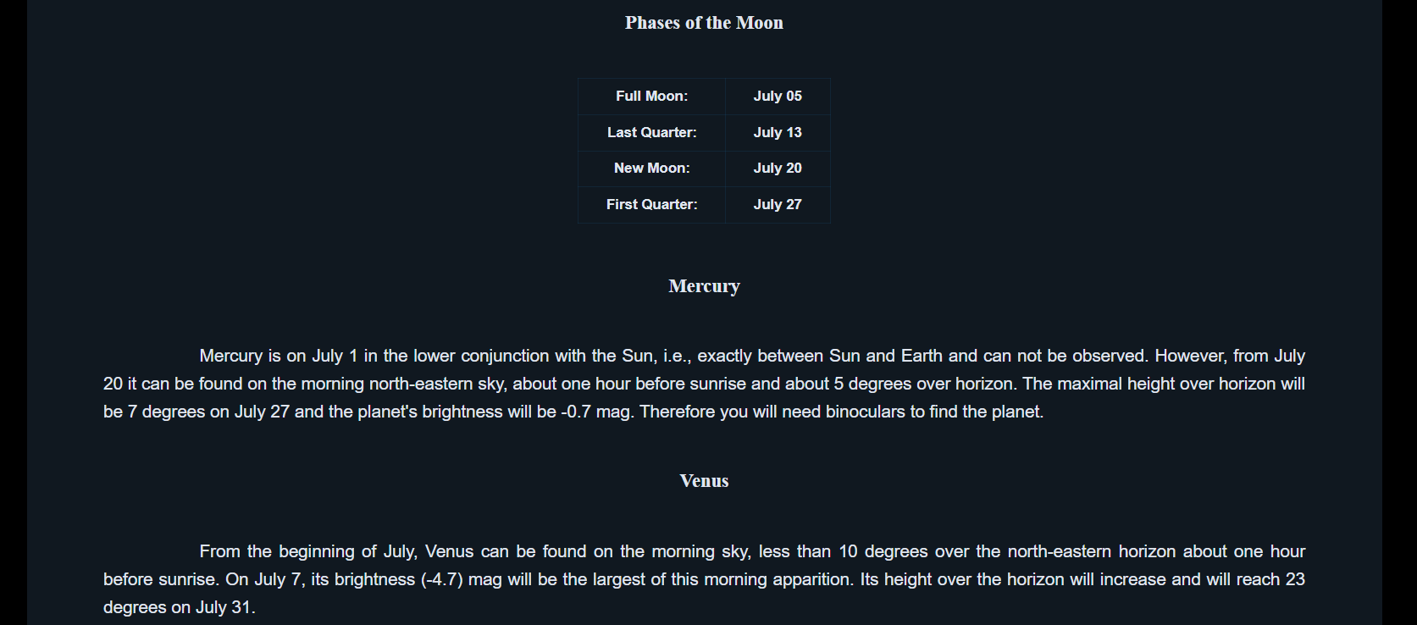
Project Output

Slide 14
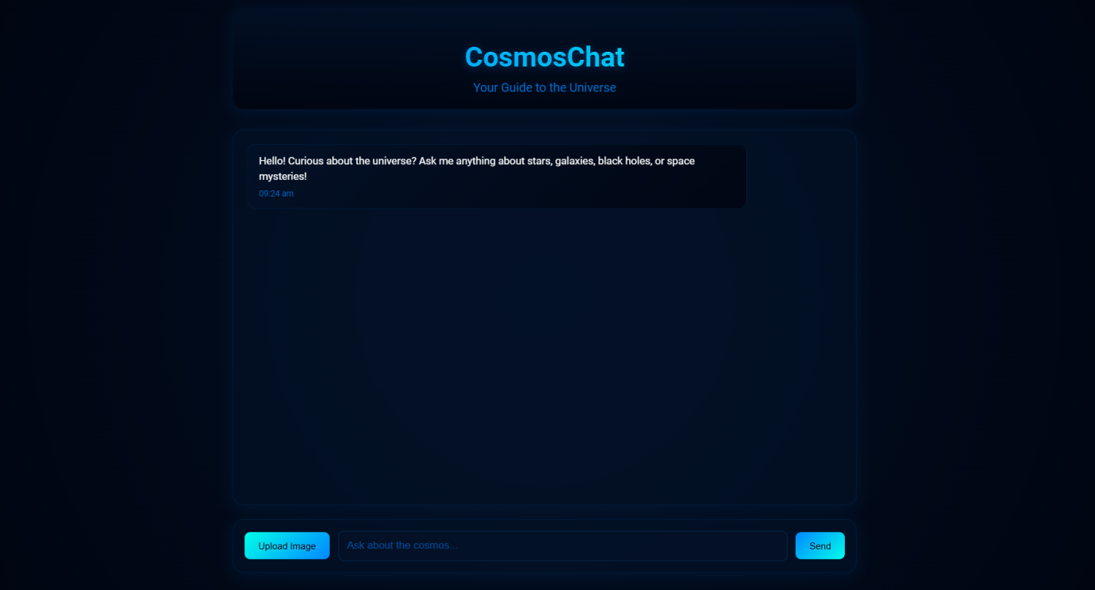
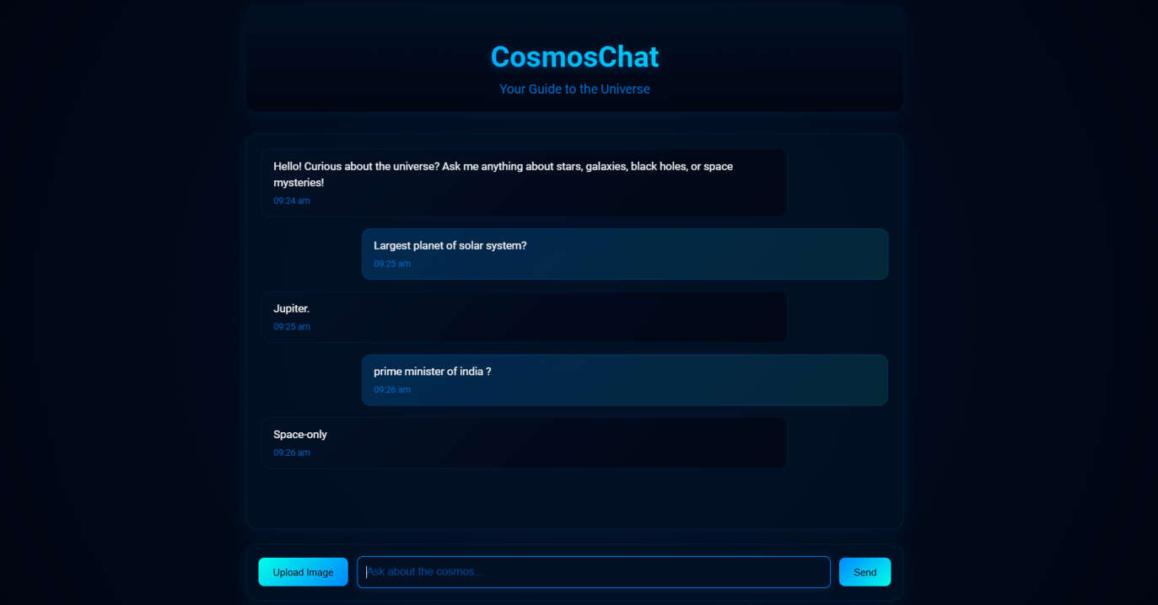
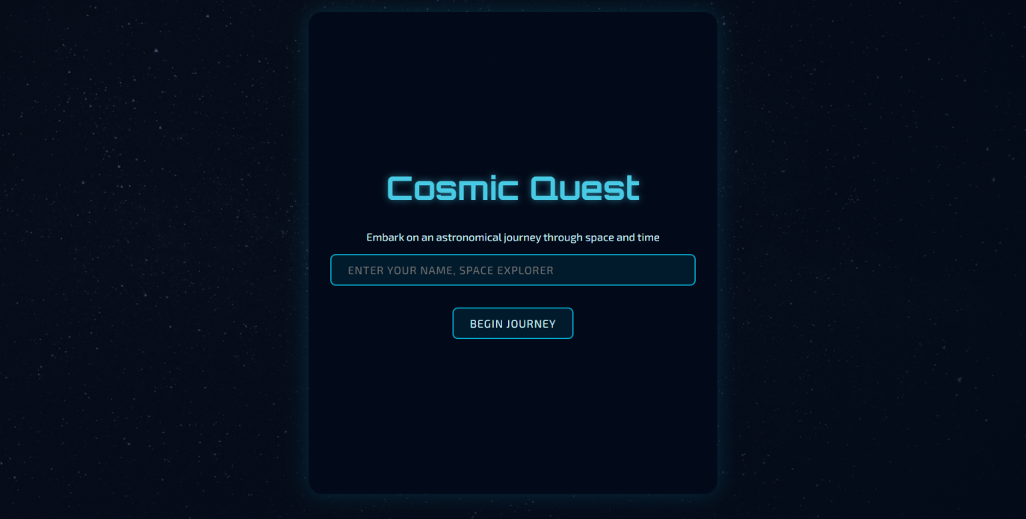
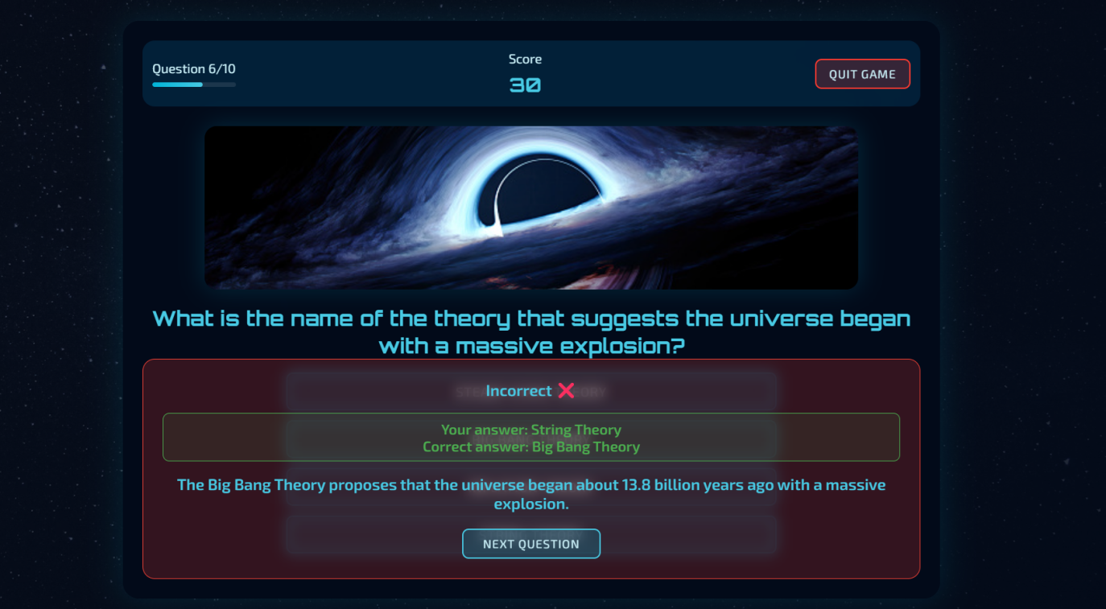
Project Output

Slide 15
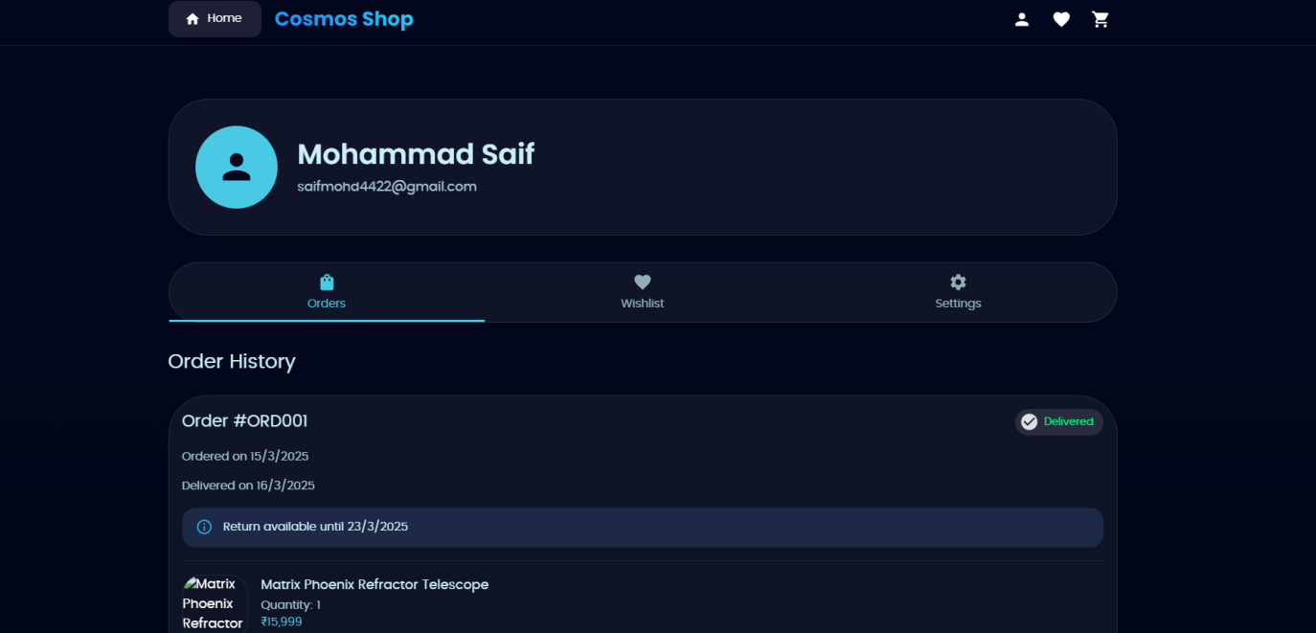
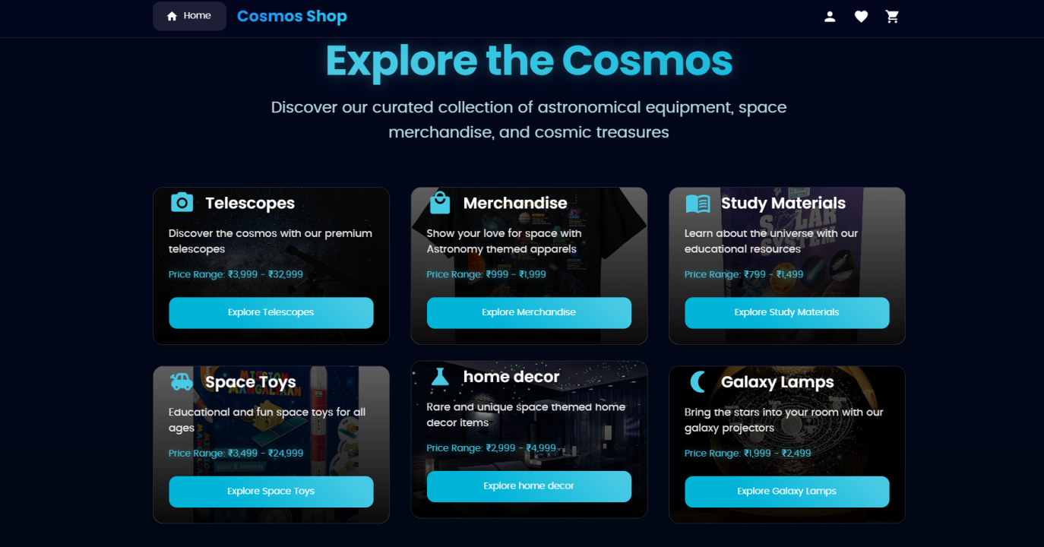
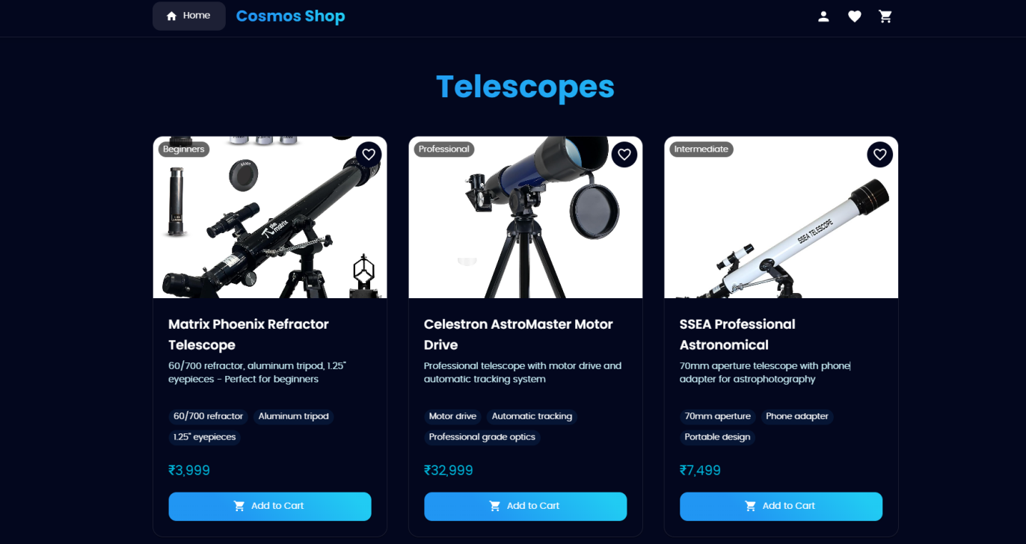
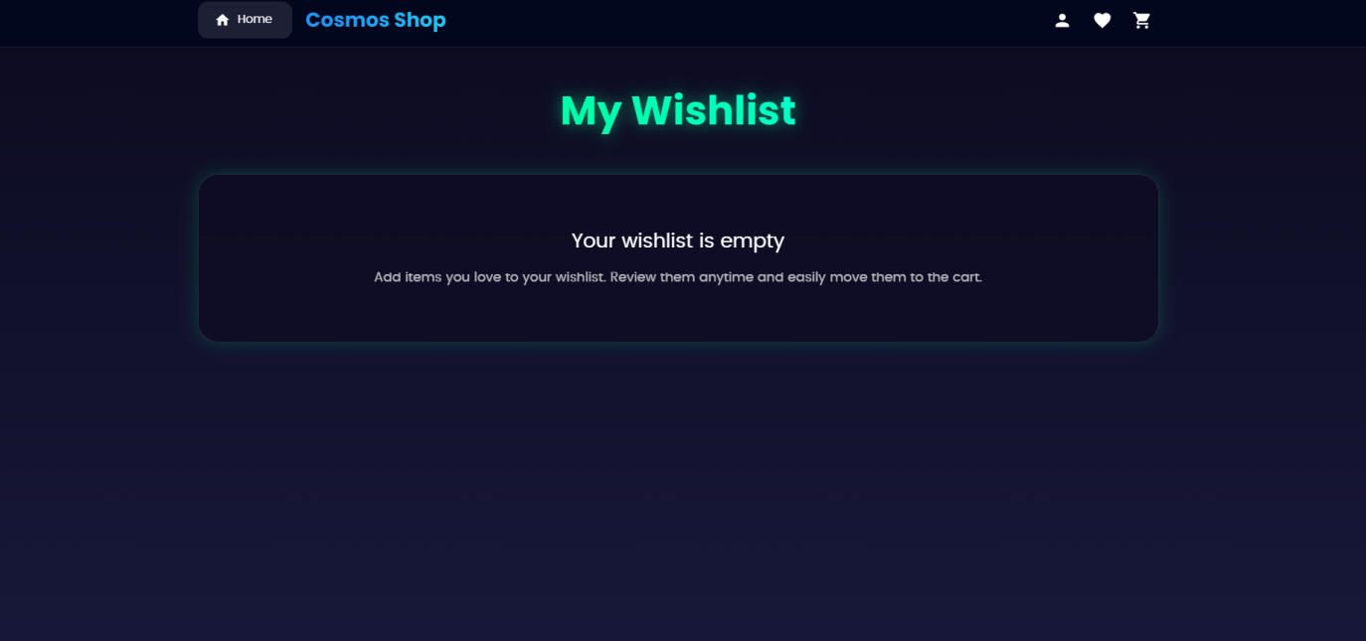
Project Output

Slide 16
Testing Strategy
Test Case for 3D Milky Way Galaxy Animation
Test Case for AI Chatbot

Slide 17
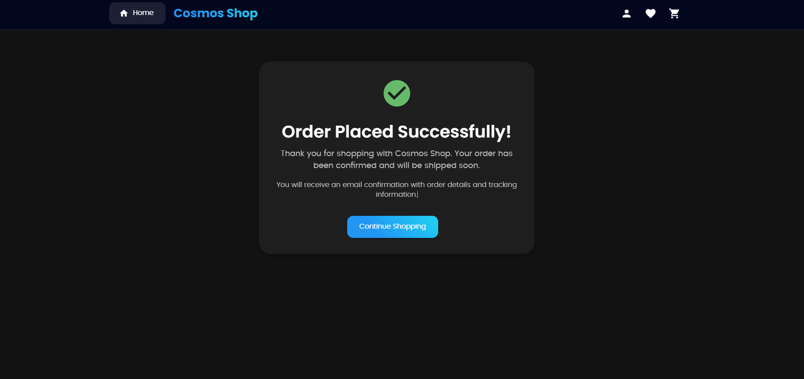
Testing Strategy
Test Case for Quiz Feature
Test Case for Product Checkout (E-commerce)

Slide 18
Conclusion
COSMOSCOPE has successfully delivered an immersive and interactive learning experience in cosmology. By integrating rich educational content with advanced visual tools such as a 3D Milky Way model, news updates, mission details, quizzes, an AI assistant, and an e-commerce section it has made complex space concepts accessible and engaging.
The platform has sparked curiosity, promoted continuous learning, and achieved its goal of making cosmology understandable for a broad audience.

Slide 19
Future Scopes
Advanced NLP: Smarter, more intuitive user interactions.
Multi-Language Support: Broaden user accessibility.
App Integration: Sync with calendars, tasks, messaging apps.
Personalization: Customizable voices, settings, and notifications.
Enhanced Security: Two-factor authentication, voice biometrics.
User Feedback: Analytics-driven updates and improvements.
Predictive Assistance: AI-powered suggestions for efficient use.

Slide 20
References
Jayant V. Narlikar. (1996) : Introduction to Cosmology. Cambridge University Press.
Tarun Kumar Das.(2015) : Cosmology and Astrophysics through Problems. Cambridge University Press

Slide 21
Thank You

